Slide 1
The Age of Imperialism
1850-1914

Slide 2
Imagine…
That you are at home engaged in one of your favorite activities; playing a game, listening to music, or reading. So far the day is as any other. Then all of the sudden a group of individuals arrive at your front door demanding that you stop what ever you are doing. These individuals tell you that your way of life is wrong. They inform you however that they have come to your house to correct your way of life. They say it is their responsibility to change your way of living for the better. You find out that this has happened not only to you but your neighbors as well. Over time your way of life does change. These individuals, who you do not even know, have changed your government, religion, and other cultural practices, and remember these individuals told you this was for your own good. What is your reaction?

Slide 3
What is Imperialism?
Imperialism
The takeover of a country or territory by a stronger nation with the intention of dominating the political, economic and social life of the people of that nation.

Slide 4
Motives of Imperialism
Motives Driving Imperialism
Nationalism
Viewed an empire as a measure of national greatness
“All great nations in their fullness of their strength have desired to set their mark upon barbarian lands”
Economic Competition
Exploration
Ideological-
European Racism
Idea that the white race was superior to others
Social Darwinism- those that were fittest for survival enjoyed wealth and successes and were considered superior to others

Slide 5
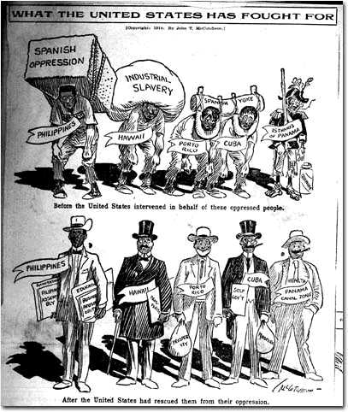
Motives of Imperialism
Motives Driving Imperialism
(Ideologic Continued…)
Missionary Impulse
Desire to Christianize people
Believed European rule was the best way to end evil practices (i.e. slave trade)

Slide 6
Motives In General
The desire for national prestige
The desire for markets for industrial goods
The need for raw materials

Slide 7
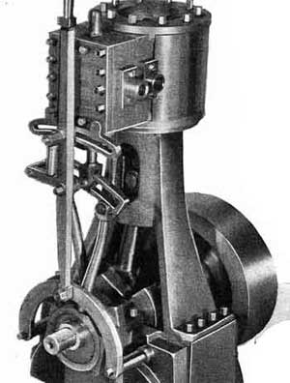
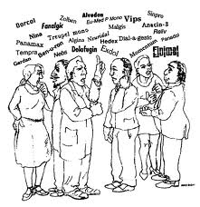
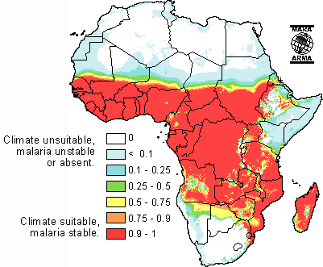
Imperialism
External Factors
- Maxim gun
- Railroads/Steamships
- Cure for malaria
Internal Factors
- Variety of cultures and languages
- Low level of technology
- Ethnic strife

Slide 8
Motives of Imperialism
Motives of Imperialism
Geopolitics
An interest in land for strategic location or product; often leads to conflict
European nations interested in specific resources in specific places but not always interested in taking over entire country
Examples: canals, oil, water access
History Alive Motives of Imperialism Activity

Slide 9
Forms of Imperialism

Slide 10
Forms of Imperialism
Forms of Imperialism | Characteristics | Example
Colony | A country of region governed internally by a foreign power | Somaliland in East Africa was a French colony
Protectorate | A country or territory with its own internal government but under the control of an outside power | Britain established a protectorate over the Niger River delta
Sphere of Influence | An area in which an outside power claims exclusive investment of trading privileges | Liberia was under the sphere of influence of the United States
Economic Imperialism | Independent but less developed nations controlled by private business interests rather than by other governments | The Dole Fruit company controlled pineapple trade in Hawaii

Slide 11
Forms of Imperialism
Indirect Control | Direct Control
Local government officials were used Limited self-rule Goal: to develop future leaders Government institutions are based on European styles but many have local rules | Foreign officials brought in to rule No self-rule Goal: assimilation Government institutions are based only on European styles
Examples: British colonies such as Nigeria, India, Burma U.S. colonies on Pacific Islands | Examples: French colonies such as Somaliland, Vietnam German colonies such as Tanganyika Portuguese colonies such as Angola

Slide 12
Global Imperialism
History Alive- Imperialism Snapshot Activity:
Respond to images of Imperialism
Complete with a partner or small group (as assigned)
Review in large group

Slide 13
Imperialism in Africa

Slide 14
The Big Scramble was on…..
….Everybody wants a piece of the cake….
Imperialism literally devours Africa. No other place on Earth will be conquered and consumed by the Europeans to the degree that Africa was.

Slide 15
Imperialism in Africa
Africa-
~Before being conquered by the Europeans, Africa was populated by 100’s of Ethnic Groups speaking over 1,000 Languages. African Societies ranged from small tribal communities to empires of 10 million people.

Slide 16
Africa Continued:
~Initial European explorations interior Africa began with David Livingstone. Henry Stanley and Cecil Rhodes also made contributions in the form of African Exploration and Colonization.
Prior to this era, Europe’s direct experience with Africa was focused on those areas bordering on the Mediterranean and other coastal areas.
An early Dutch Colony had been established in Cape Town, South Africa

Slide 17
Africa Continued:
European Interest in Africa had been steadily increasing through the 17th and 18th centuries as many European nations became involved in the Slave Trade.
Independent nations however, included Ethiopia (led by Menelik II) and Liberia (established by the United States as a colony for freed slaves).
Liberia was under the sphere of influence of the U.S.
Assignment- Complete the Africa Map
Soundtrack for Mapping!

Slide 18
Africa Continued:
~ 5 Motivating Factors behind Imperialism:
1. Economic
2. Political
3. Ideological
4. Religion
5. Exploratory
Which of these factors were directly related to the Industrial Revolution which had preceded the era of Imperialism?

Slide 19
Africa continued:
Inventions of the Industrial Revolution such as the Steam Engine (Steam powered River Boats) and the Maxim Gun gave the Europeans a huge advantage over the native African populations.
European Nations embarked on a mad scramble for land beginning in 1880.
In 1882 Belgium established control of the Congo. Soon thereafter, Britain, Germany, Italy, Spain and Portugal all had claims to African lands.

Slide 20
Africa continued:
European nations were so intent on gaining territory in Africa that they often claimed land and reclaimed land from each other.
To address this problem, the Berlin Conference was held in 1884/1885.
14 European nations met to establish rules for the division of Africa
They Agreed that any European nation could claim land in Africa by notifying other nations of their claims and showing they could control the area.
By 1914 only Ethiopia and Liberia were unclaimed.
Complete Packet pg. 6-7 Ch. 11, Sect. 1 and 2 in text.

Slide 21
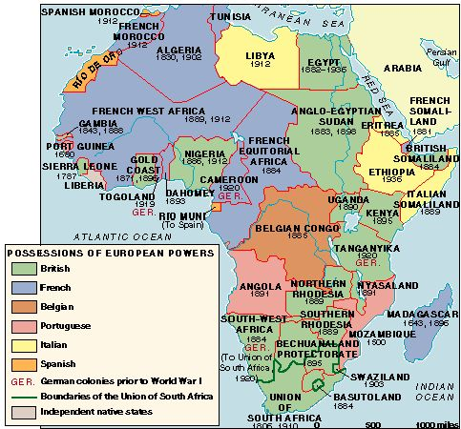
AFRICA- 1914

Slide 22
Africa 1914

Slide 23
Berlin Conference

Slide 24
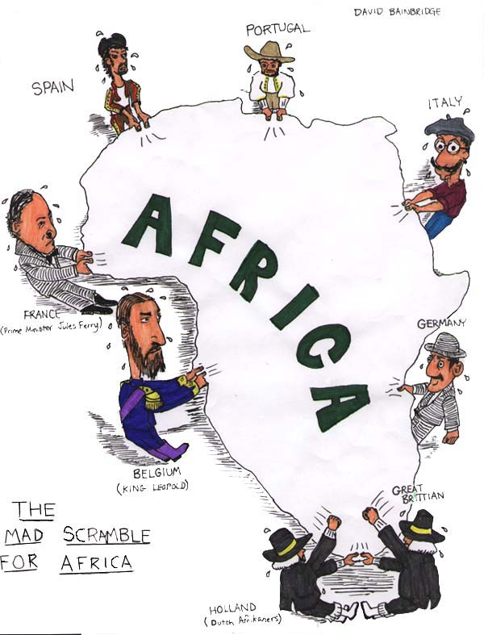
Assignment
Based on the cartoon pictured, discuss with the person sitting next to you the following two questions
According to this cartoon, which European countries were fighting for a position in Africa?
How did the Berlin Conference lead to the situation shown in the cartoon?

Slide 25
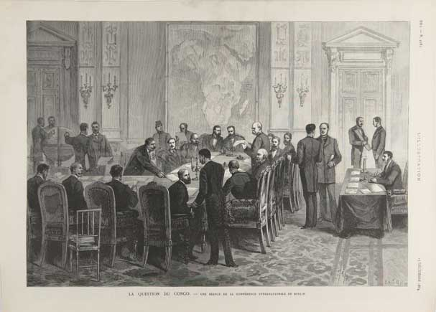

Slide 26
Imperialism
Berlin Conference (1884-85)
European conference that met to lay down rules for the division of Africa
Agreement→ Any European country could claim land in Africa by notifying other nations of their claims and showing they could control the area
No African ruler attended meetings
http://www.youtube.com/watch?v=OJe1W_HIWmA

Slide 27
What was it like?
Discuss with a partner what you think it must have been like upon seeing the Europeans for the first time? Prepare to share 2-3 sentences describing this encounter?
After discussing with class, read packet page 15-
“the Arrival of the Europeans”
- answer questions on pg. 16.

Slide 28
King Leopold’s Ghost- Day 1
While viewing the documentary, respond in writing to the following questions:
1) For whom was the Congo originally colonized?
2) How did King Leopold hide his true operations from the rest of the world?
3) What methods were used to control the territory?
4) List 5 examples of outright brutality used towards the native population ?
5) What was the Motive for King Leopold/Belgium imperializing the Congo?
6) What were the greatest source of profits for King Leopold?

Slide 29
King Leopold’s Ghost- Day 2
What is the legacy of imperialism in the Congo?
How does King Leopold’s reign still haunt the Congolese?
Should we blame the problems plaguing the Congo today on Westerners only?
4. What role has America played in this crisis and what role do they continue to play?
5. What role has capitalism played in this crisis?
6. What can be done to resolve this crisis?

Slide 30
Who is winning the “Great or Amazing Race”?
Take a look at the following map.
From what you see on the map, using the key and your knowledge of imperialism, who appears to be winning the “race” and why?
Discuss with your neighbors and prepare to share your answer.

Slide 31
Imperialism: Partition of Africa

Slide 32
Cecil Rhodes- his vision for England

Slide 33
Views and commentary on Imperialism…
Imperialism was vastly supported by most Europeans living in the nations of the continents largest conquerors. Many associated the expansion of territory and empire with a sense of extreme national pride ~nationalism.
However, there were many critics of these efforts as well, both in Europe and in the United States. One of the most pointed critics was George Washington Williams who published an “Open Letter” recounting his first hand experience in the Belgian Congo. (This letter is detailed in King Leopold’s Ghost).

Slide 34
White Man’s Burden
Imperialism was often seen as the obligation or duty of Industrialized nations. Many Europeans called upon the U.S. to “join in the fun”.
Debate over U.S. imperialism at the turn of the twentieth century occurred not only in newspapers and political speeches, but in poetry as well. In 1899, the British novelist and poet Rudyard Kipling wrote the poem "The White Man’s Burden," which urged the U. S. to take up the "burden" of empire, as had Britain and other European nations. Theodore Roosevelt, soon to become vice-president and then president, copied the poem and sent it to his friend, Senator Henry Cabot Lodge, commenting that it was "rather poor poetry, but good sense from the expansion point of view." Other authors, by contrast, wrote parodies and critiques of Kipling’s poem and the imperial ideology it espoused.
"The Black Man’s Burden" and "The Poor Man’s Burden," by H.T. Johnson and George McNeil, respectively, were two such parodies.

Slide 35
Assignment: White Man’s Burden by Rudyard Kipling
Take up the White Man’s burden—
Send forth the best ye breed—
Go, bind your sons to exile
To serve your captives’ need;
To wait, in heavy harness,
On fluttered folk and wild—
Your new-caught sullen peoples,
Half devil and half child.
According to Kipling, what is the “White Man’s burden”?

Slide 36
Assignment
Go to http://historymatters.gmu.edu/d/6609/ and read White Man’s Burden, Poor Man’s Burden and Black Man’s burden
Read and complete packet page 8.

Slide 37
Questions…
As you read, answer the following questions to guide your understanding of the poems.
1. According to Kipling, and in your own words, what was the "White Man’s Burden"?
2. What reward did Kipling suggest the "White Man" gets for carrying his "burden"?
3. Who did Kipling think would read his poem? What do you think that this audience might have said in response to it?
4. For what audiences do you think H.T. Johnson and George McNeil wrote their poems? How do you think those audiences might have responded to "The Black Man’s Burden" and "The Poor Man’s Burden"?

Slide 38
The white man’s burden- The Journal, Detroit 1899

Slide 39
British Imperialism

Slide 40
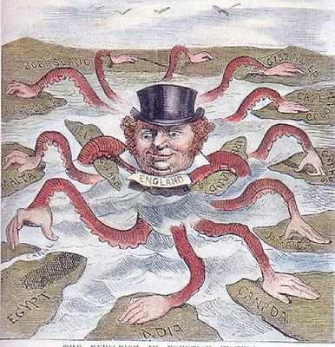
British Imperialism
British Imperialism
British dominated 19th century imperialism
Reached it’s height under Queen Victoria
Jump start due to early industrialization
Originally about economics→ PRIDE
Glorified imperialism in stories, newspapers, poetry
Ex. Kipling’s White Man’s Burden
Major Rivals:
France
Germany
Belgium

Slide 41
RHODES COLOSSUS
Cecil Rhodes, shown standing astride of Africa, in a cartoon from Punch magazine; Rhodes had built the trans-Africa railway, and is the man after whom the nation of Rhodesia was named (now Zimbabwe). The cartoon is a play on the old Colossus of Rhodes, which was one of the “Seven Wonders of the Ancient World.”)
“We [the British] happen to be the best in the world, with the highest ideals of dependency and justice and liberty and peace, and the more of the world we inhabit, the better it is for humanity.”

Slide 42
Cecil Rhodes…
Cecil Rhodes was a British explorer, investor, opportunist and imperialist. Rhodes epitomized the attitudes of those who wholeheartedly supported Imperialism.
Rhodes became one of the wealthiest imperialists of the era- the Rhodes Scholarship was created by him over 100 years ago and continues to this day.
The following quotes provide insight into the mindset of Rhodes and other Imperialists…

Slide 43
Cecil Rhodes

Slide 44
Cecil Rhodes 1853-1902
Rhodes moved from England to South Africa as a boy
Become involved in the Diamond Industry, founded DeBeers Mining Inc.
Later attended Oxford University, established the “Rhodes Scholarship”
Instrumental in Expanding Britain’s control of African territories by obtaining mining rights
Wanted to connect South Africa and Cairo, Egypt by British Controlled Colonies
Named Rhodesia after himself, now Zimbabwe

Slide 45
Cecil Rhodes

Slide 46
Rhodes- Scholarly Quotes…..
Rhodes famously declared: "To think of these stars that you see overhead at night, these vast worlds which we can never reach. I would annex the planets if I could; I often think of that. It makes me sad to see them so clear and yet so far."^{[17]}
“We must find new lands from which we can easily obtain raw materials and at the same time exploit the cheap slave labor that is available from the natives of the colonies. The colonies would also provide a dumping ground for the surplus goods produced in our factories.”^{[18][19]}
“Pure philanthropy is very well in its way but philanthropy plus five percent is a good deal better.”^{[20]}
"I contend that we are the first race in the world, and that the more of the world we inhabit the better it is for the human race...If there be a God, I think that what he would like me to do is paint as much of the map of Africa British Red as possible...“
"In order to save the 40 million inhabitants of the United Kingdom from a bloody civil war, we colonial statesmen must acquire new lands to settle the surplus population, to provide new markets for the goods produced by them in the factories and mines..."

Slide 47
Cecil Rhodes 1853-1902
Rhodes wanted to expand the British Empire because he believed that the Anglo-Saxon race was destined to greatness.
In his last will and testament, Rhodes said of the British, "I contend that we are the finest race in the world and that the more of the world we inhabit the better it is for the human race." He wanted to make the British Empire a superpower in which all of the white countries in the empire, including Canada, Australia, New Zealand, and Cape Colony, would be represented in the British Parliament. Rhodes included Americans in the Rhodes scholarships and said that he wanted to breed an American elite of philosopher-kings who would have the USA rejoin the British Empire. Rhodes also respected the Germans and admired the Kaiser, and allowed Germans to be included in the Rhodes scholarships. He believed that eventually Great Britain, the USA and Germany together would dominate the world and ensure peace together.[

Slide 48
Rhodes, Continued
In his first will, of 1877, (before he had accumulated his wealth), Rhodes wanted to create a secret society that would bring the whole world under British rule.^{[3]} The exact wording of the will is:
To and for the establishment, promotion and development of a Secret Society, the true aim and object whereof shall be for the extension of British rule throughout the world, the perfecting of a system of emigration from the United Kingdom, and of colonisation by British subjects of all lands where the means of livelihood are attainable by energy, labour and enterprise, and especially the occupation by British settlers of the entire Continent of Africa, the Holy Land, the Valley of the Euphrates, the Islands of Cyprus and Candia, the whole of South America, the Islands of the Pacific not heretofore possessed by Great Britain, the whole of the Malay Archipelago, the seaboard of China and Japan, the ultimate recovery of the United States of America as an integral part of the British Empire, the inauguration of a system of Colonial representation in the Imperial Parliament which may tend to weld together the disjointed members of the Empire and, finally, the foundation of so great a Power as to render wars impossible, and promote the best interests of humanity.

Slide 49
Cecil Rhodes

Slide 50
Cecil Rhodes- So what do you think of him? Great Guy?
"I admire him, I frankly confess it; and when his time comes I shall buy a piece of the rope for a keepsake“
~ Mark Twain

Slide 51
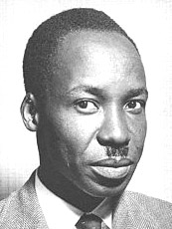
Imperialism: Perspective
“Our whole existence has been controlled by people with an alien attitude to life, people with different customs and beliefs. They have determined the form of government, the types of economic activity, and the schooling which our children have…A man who tries to control the life of another does not destroy the other any less because he does it, as he thinks, for the other’s benefit. It is the principle which is wrong, the principle of one man governing another without his consent.” -Julius Nyerere of Tanzania
With a neighbor-
1) discuss what is being said in the quote.
2) Create a response for the Tanzanian’s using John Locke’s ideas

Slide 52
British Imperialism
British Imperialism in India
India was the largest and most lucrative colony of the entire British Empire.
1600’s British East India Co. began trading in India; over time gaining more economic and POLITICAL control
“Jewel in the crown”→ the most valuable of all the British colonies
Period of British rule was known as the “Raj”

Slide 53
British Rule in India
The East India Company controlled India and operated in India under the Authorization of the government of England.
As an Imperial holding, India became so successful, it was became referred to as the “Jewel of the Crown”.
To Maintain control, the E.I.C. relied on a military made up of Sepoy’s (Indian’s serving under the command of the British).
Resentment built reaching a crisis with the Sepoy Rebellion and the Cawnpore massacre.

Slide 54
The Sepoy Rebellion
The Sepoy Rebellion or Uprising was fueled in part by rumors. Years of discontent and objection to oppression came to a collision point when rumors spread that the British were trying to undermine the tenants of the Indian religions (Hindu and Muslim) by forcing them to bite the top off of the ammunition cartridge.
The cartridges were sealed with animal fat (pork and beef) both of which may not be consumed be the respective religions-
- Pork- Muslim
- Beef- Hindu
The rumors were that the British intentionally used these products to intentionally force the Indians to violate their religious beliefs.
In response, the Sepoys attacked the British- the Sepoy uprising.
~ Also known as the “First Indian War for Independence”.

Slide 55
Imperialism in India
Long-Term Effects of Colonization in India
Resurgence of nationalism against GB
Creation of:
Indian National Congress-1855
Mix of all Indians
Muslim League-1906
Just Muslim Indians
Goal: push for independence and protection of Muslim rights
Strong tension continues to develop between Hindus and Muslims as nationalism is on the rise

Slide 56
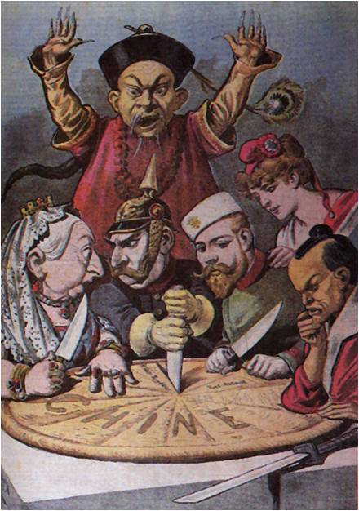
Imperialism in China

Slide 57
Imperialism in China
Imperialism in China
Chinese had firm traditions →stable & secure
Looked down at outsiders
Had strong agricultural economy
Foreign traders brought new products – foods – led to population boom in 18th Century
Strong mining and manufacturing
Many natural resources – salt, tin, silver, iron ore
Produced fine silks, cottons, porcelain

Slide 58
Imperialism in China
Tea/Opium Connection
Chinese self sufficient → did not need to trade WITH West but did trade TO West
British wanted to find a good (product) Chinese would want to buy to improve trade balance
OPIUM!
Used as pain reliever in Chinese medicine
Highly addictive
Over 12 million were hooked by 1830

Slide 61
Imperialism in China
“By what right do they (British Merchants) …use the poisonous drug (opium) to injure the Chinese people?...I have heard that the smoking of Opium is strictly forbidden by your country…Since it is not permitted to do harm to your own country, then even less should you let it be passed on to the harm of other countries.”
Lin Zexu, quoted in China’s Response to the West

Slide 62
Imperialism in China
Opium War
The British refused to stop trading OPIUM
China begins naval battle with British to stop sale of Opium
China easily DEFEATED
Effects:
Effects
HONG KONG given to G.B.
Special rights given to G.B. – exempt from trade laws at ports

Slide 63
The British Empire
With territorial holdings around the globe that included:
Canada, South Africa, India, Hong Kong and Australia, Great Britain dominated the Era of Imperialism
“The Sun Never Sets on the British Empire”
~This famous adage was factually accurate.

Slide 64
Imperialism in China
Issues in China
POPULATION had grown dramatically
Food supply lacking
Government CORRUPTION
Opium use INCREASING
WHAT’S A NATION TO DO?
Overthrow the government, of course!
TAIPING REBELLION &
BOXER REBELLION

Slide 65
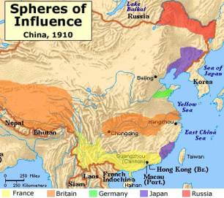
Self Strengthening Movement
Effects of Instability in China
Foreigners import resources for MILITARY
China loses control of QUALITY and in trade balance
Increasing WESTERN INFLUENCE
Public not overly supportive of program
Foreigners attack
Other countries capitalize on China’s weaknesses
Resulting treaties lead to “FOOTHOLDS”—spheres of influence

Slide 66
Assignment
Use pages 335-339 in text to provide an overview of the causes, effects, and policies that affected China in the 1800s and 1900s. Fill out corresponding graphic organizer!
Causes | Events/Policies | Effects
 | Opium War
 | Taiping Rebellion
 | Self-Strengthening Movement
 | Open Door Policy
 | Boxer Rebellion

Slide 67
How did Japan prevent imperialistic takeover in the 18th Century?
Homework:
Unit 3: Industrialization and Imperialism test tomorrow
Industrialization, Imperialism in Africa, India, Asia
Resources:
Unit 3 review guide (Important Documents)
Quia Activities and Industrial Revolution quiz (MWH calendar)
Jeopardy Review (class)
Online Text review activities
CORE Assessment #1 due Monday, Nov. 1st

Slide 68
Imperialism in Japan

